Slide 1
Uniforms
Hosein Ghahremanzadeh
Notes:
The background is a sample of volumetric lighting in my own 3D graphics engine, HG3D

Slide 2
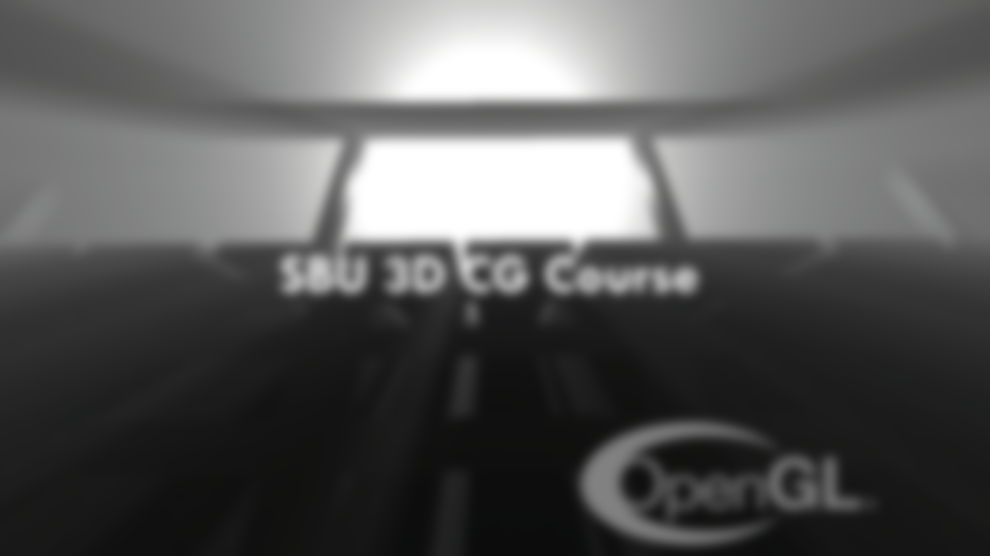
Uniform Variables
Uniform variables are used to pass parameters to program.
Uniform variables are modifiable by the user of the program.
The program itself can’t modify the uniform variables.
The value of uniform variables are part of program’s state.
Notes:
Uniform variables are not modifiable inside the shaders, hence the name uniform.

Slide 3
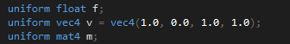

GLSL Declaration
Uniform variables are declared as global variable.
$Uniform$ keyword is used to declare uniform variables.
Uniform variables can be initialized on declaration.

Slide 4
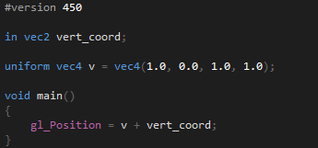
Accessing Inside Shaders
Inside shaders uniform variables are accessible as constant variables.

Slide 5
Accessing as User of Program
To access a uniform variable, the location of the program is required.
The location of the program can be determined at declaration of the variable.
If the location of the uniform is not determined at declaration GL it self will assign a location to the variable.
The location of the uniform is retrievable by the user of the program.
Notes:
We are not going to discuss assigning location at deceleration time.

Slide 6


Retrieving Location
$glGetUniformLocation$ is used to retrieve uniform variable location.
If a location has been assigned to a uniform variable at declaration time, it is guaranteed that $glGetUniformLocation$ returns the assigned location.
No two variables may have the same locations.
Locations of uniform variables do not change after linkage of the program.
All basic uniform variables get a unique location.
Array and struct type variables get a unique location for each of their components.
Notes:
The $glGetUniformLocation$ function gets the program id and variable name as input and returns the location of the uniform.
Since the uniform variable locations are fixed after linkage, it is more efficient to get the location once at initialization and store it for further use for accessing the variable as user of the program.

Slide 7


Setting the Value
$glUniform$ is used to set uniform variable value.
$glUniform$ sets the value of a uniform variable on the current program.
Different variations of $glUniform$ are available for different types of variables.
Notes:
The $glUniform$ function gets the uniform location and the value(s) and sets the uniform variable of the current program.
The $glUniformMatrix$ is available for matrix types.

Slide 8


Setting the Value
$glUniform$ needs the program to be current in order to set the value of the uniform variable.
since OpenGL 4.1, $glProgramUniform$ function is available that unlike $glUniform$ gets program ID as input parameter and sets the uniform variable’s location.

Slide 9
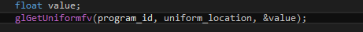

Getting the Value
$glGetUniform$ is used to get uniform variable value.
Unlike $glUniform$, $glGetUniform$ get’s the program ID as input.
$glGetUniform$ returns the value of the uniform variable via an output parameter.
Notes:
The $glGetUniform$ get’s the program ID, uniform variable location, and a pointer of type of the uniform variable, and write the value of the uniform variable to the output parameter.

Slide 10
Putting It All Together
Declare Uniform Variable on Shader
Get Uniform Location
Set Current Program
Set Current Program
Set Uniform Variable Value
Use in Shader as Constant Variable
Notes:
The $glGetUniform$ get’s the program ID, uniform variable location, and a pointer of type of the uniform variable, and write the value of the uniform variable to the output parameter.

Slide 11
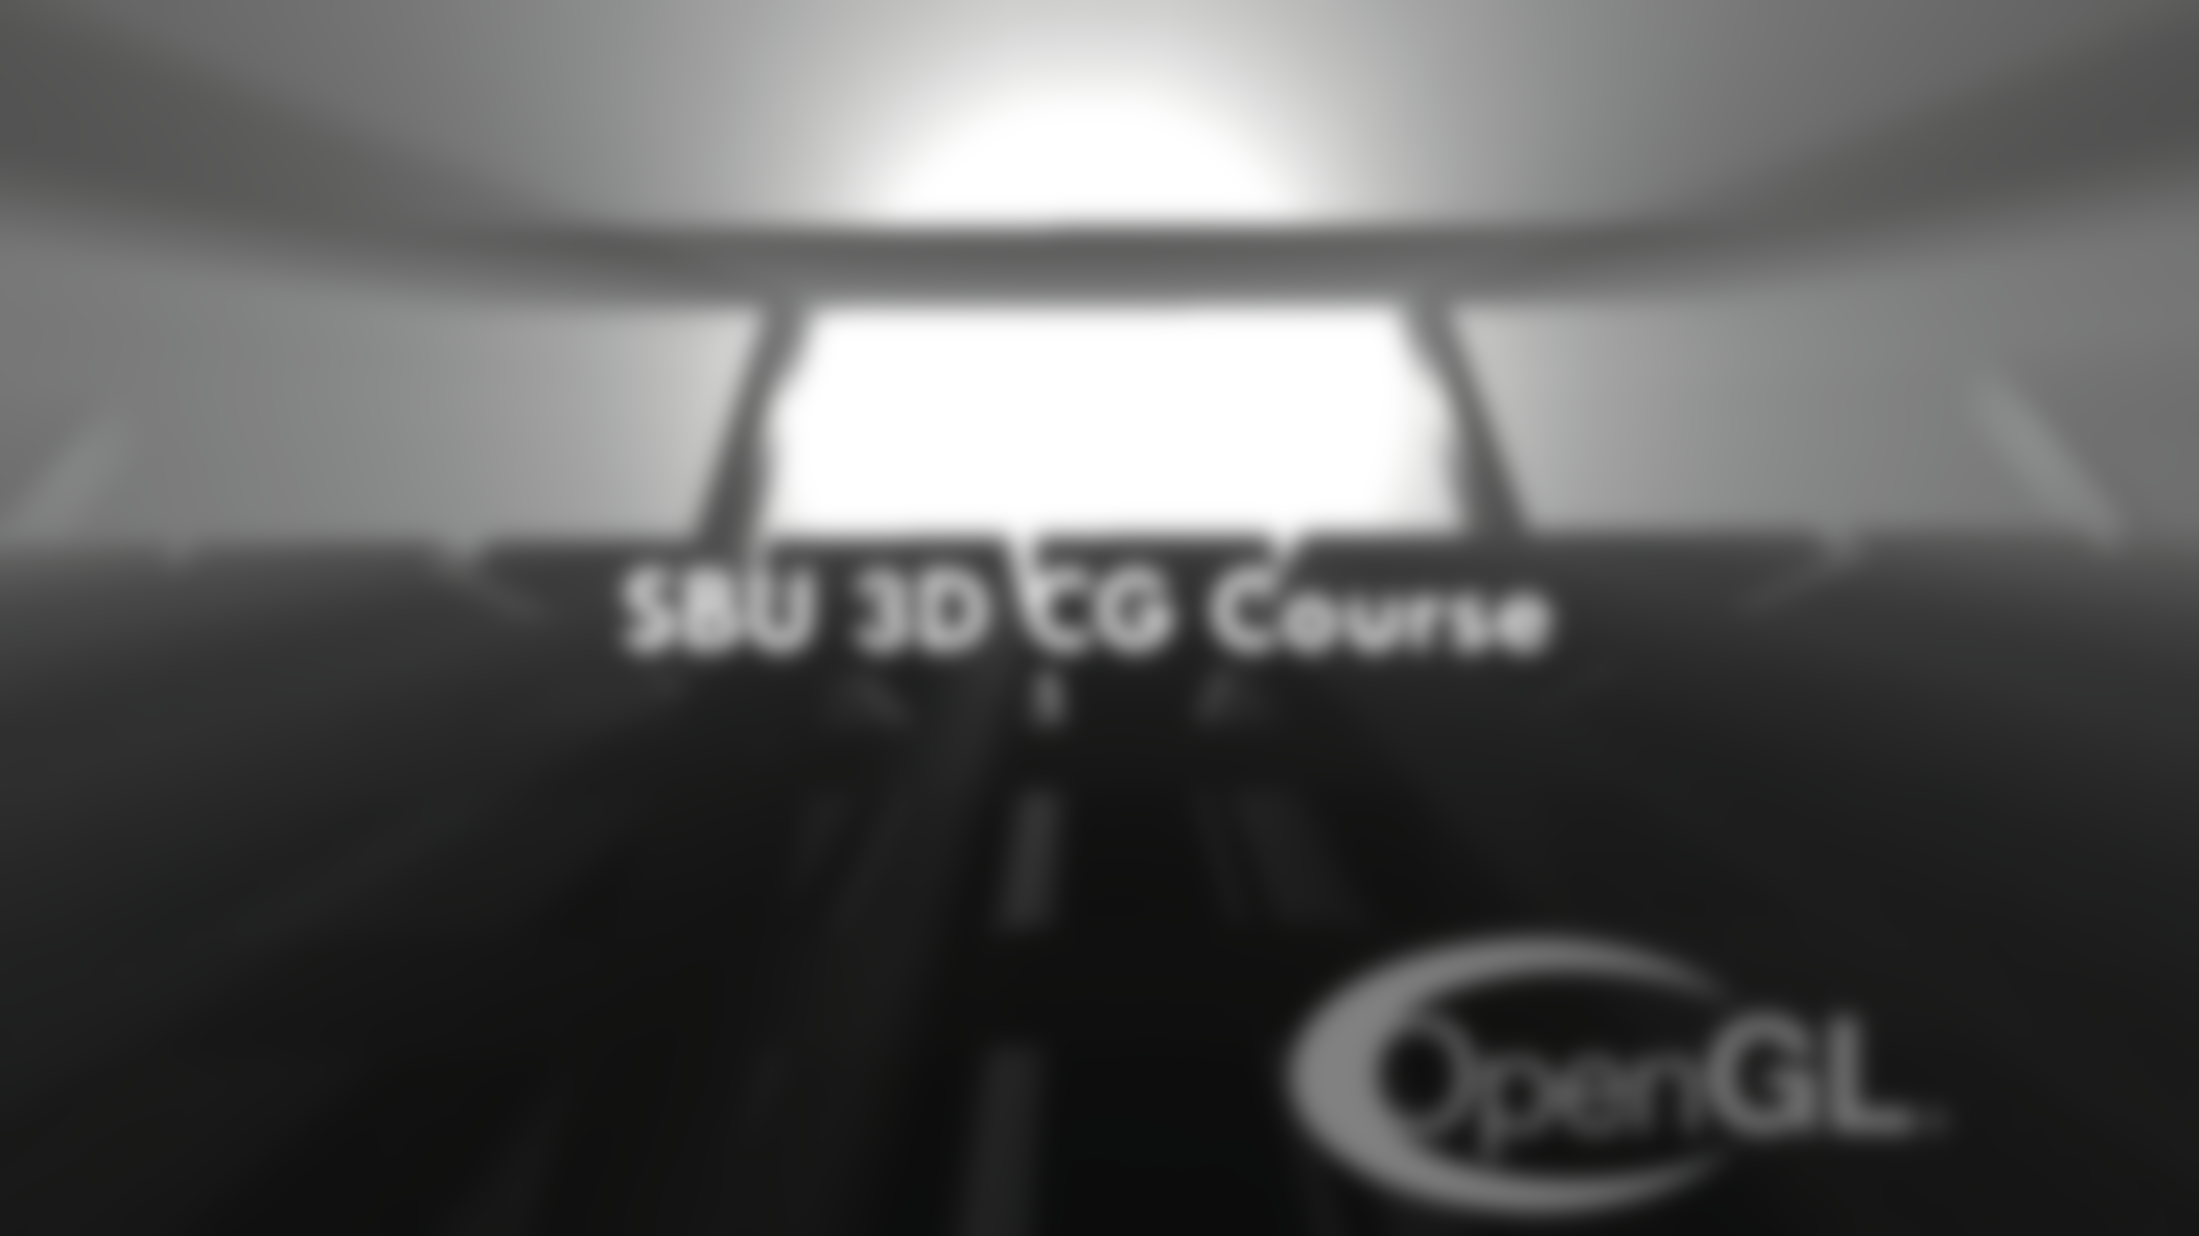
Your questions

Slide 12
Helpful links
https://www.khronos.org/opengl/wiki/Uniform_(GLSL) (GLSL Uniforms)
https://www.khronos.org/registry/OpenGL-Refpages/gl4/html/glUniform.xhtml (glUniform Function)
https://www.khronos.org/registry/OpenGL-Refpages/gl4/html/glProgramUniform.xhtml (glProgramUnifom Functon)
https://www.khronos.org/registry/OpenGL-Refpages/gl4/html/glGetUniform.xhtml (glGetUniform Function)
Notes:
https://www.khronos.org/opengl/wiki/Uniform_(GLSL) (GLSL Uniforms)
https://www.khronos.org/registry/OpenGL-Refpages/gl4/html/glUniform.xhtml (glUniform Function)
https://www.khronos.org/registry/OpenGL-Refpages/gl4/html/glProgramUniform.xhtml (glProgramUnifom Functon)
https://www.khronos.org/registry/OpenGL-Refpages/gl4/html/glGetUniform.xhtml (glGetUniform Function)

